Slide 1
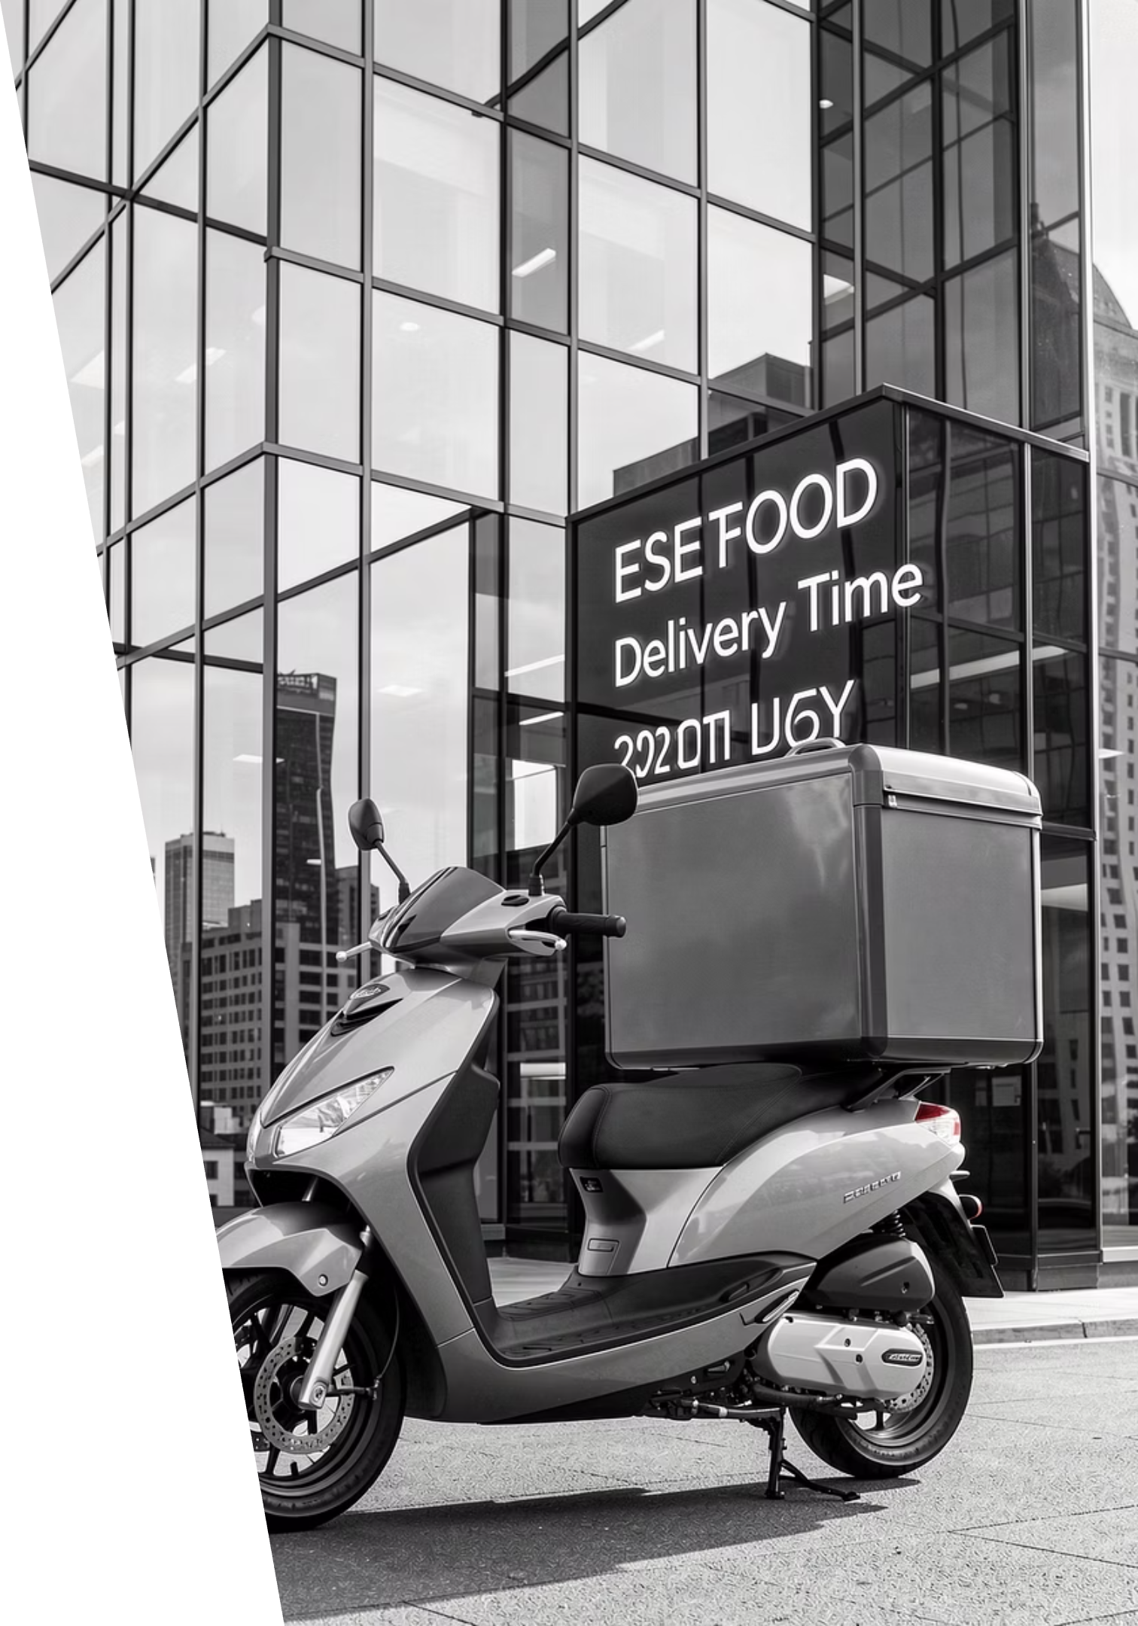
Food Delivery Time Estimation with Machine Learning
Predicting precise delivery times to optimize logistics and enhance customer satisfaction.

Slide 2

The Problem: Inaccurate ETAs
Food delivery services frequently rely on static rules for estimated arrival times (ETAs).
These traditional methods often lead to inaccurate predictions, causing:
Customer dissatisfaction due to late deliveries.
Operational inefficiencies for delivery partners and restaurants.
Missed opportunities for optimizing delivery routes and resource allocation.

Slide 3

Dataset Overview: Fueling Accurate Predictions
Our predictive model is built upon a robust dataset, capturing critical elements of the delivery process:
Volume: 45,593 unique delivery records.
Features:
Delivery partner age and rating
Restaurant and delivery latitude/longitude
Order type and vehicle type
Target Variable: "Delivery Time" in minutes, providing a clear metric for prediction.

Slide 4
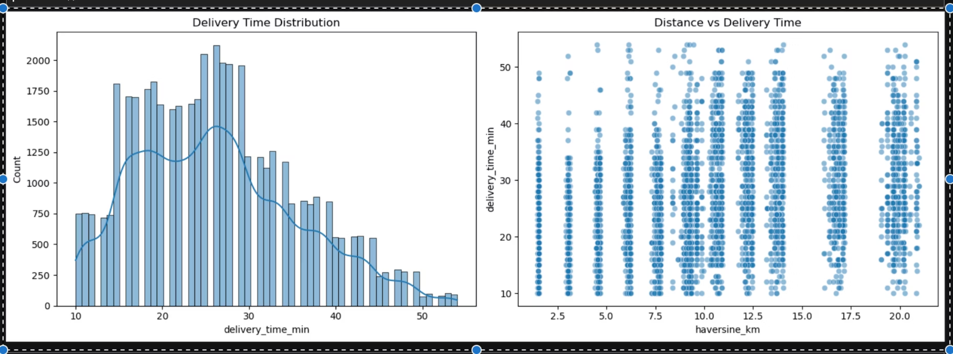
Exploratory Data Analysis: Key Insights
Initial analysis revealed important patterns and potential areas for feature engineering.
Distribution plots highlighted varied delivery times, suggesting non-linear relationships.
Scatter plots indicated correlations between certain features (e.g., rider age, distance) and delivery duration.
Outliers were identified, particularly in geographic coordinates and partner metrics, necessitating robust cleaning strategies.

Slide 5


Data Preparation: Cleaning & Feature Engineering
Preprocessing
Feature Engineering
Standardized column names, converted data types, and addressed inconsistencies:
Created new features to capture spatial and relational aspects:
Clipped unrealistic age/rating values.
Imputed invalid geo-coordinates using city-wise medians.
Haversine and Manhattan distances.
Absolute lat/lon differences and distance buckets.
Extracted city, restaurant, and rider codes from IDs.
These steps were crucial for transforming raw data into a format suitable for machine learning.

Slide 6
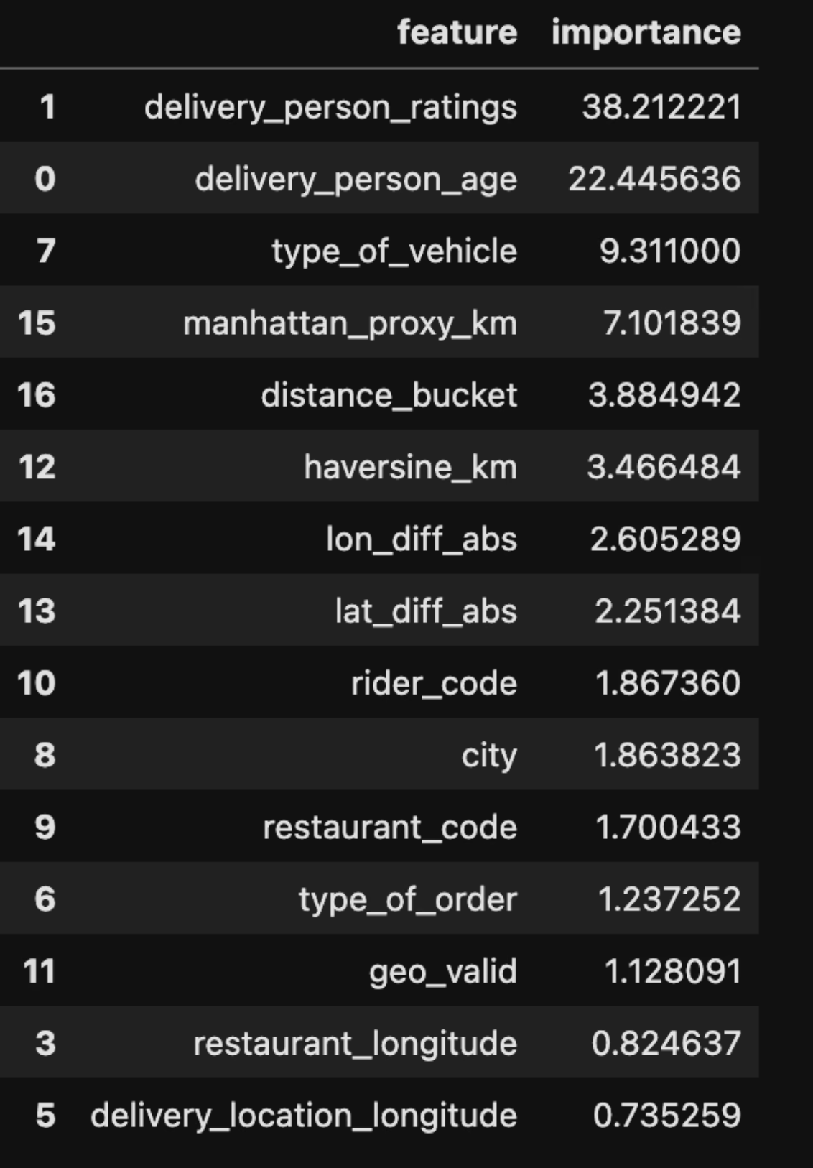
Modeling Approach: Comparing Regression Techniques
We evaluated three distinct regression models to identify the most effective solution for ETA prediction:
Linear Regression: A foundational model for establishing baseline performance.
Random Forest: An ensemble method known for its robustness and handling of complex interactions.
CatBoost: A gradient boosting algorithm specifically chosen for its capabilities with categorical and geographical features.

Slide 7
Model Performance: CatBoost Leads the Way
CatBoost demonstrated superior performance across all metrics, with the lowest RMSE and MAE, and the highest R² value.
This indicates its effectiveness in capturing the nuances of the delivery time estimation problem.
The targeted approach of CatBoost for geographical and categorical features proved highly beneficial.
Model
RMSE
MAE
R²
CatBoost (Geo + Categorical)
7.2588
5.6974
0.3990
Random Forest
7.5899
5.9349
0.3430
Linear Regression
7.8313
6.2560
0.3005
Based on the provided Jupyter cell output for model comparison results.

Slide 8
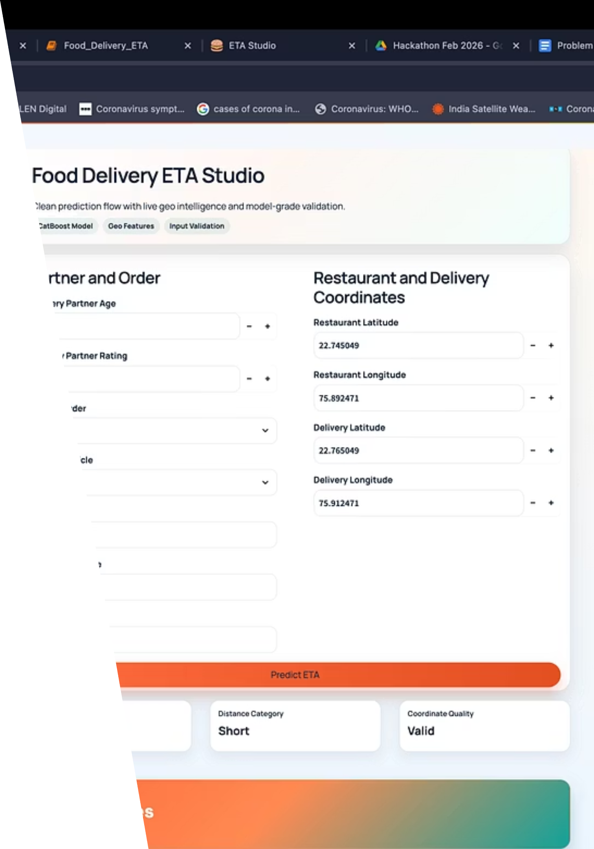
Production-ready Streamlit app that predicts delivery time in real time using our trained CatBoost model.
User enters rider, order, and location details.
App validates required fields and coordinate quality.
Geo features are computed automatically (distance, bucket, route proxies).
Model returns ETA instantly in minutes.

Slide 9





Deployment Demo: Live ETA Prediction App
Our machine learning model is now live and integrated into a Streamlit application, providing real-time ETA predictions:
REAL-TIME PREDICTION READY
User inputs order + location details
App validates required fields and coordinates
Geo features are computed automatically
CatBoost model returns ETA in minutes
Input
Validation
Feature Engineering
Model
ETA Output
Deployment completed using Streamlit for real-time business use.

